Slide 1
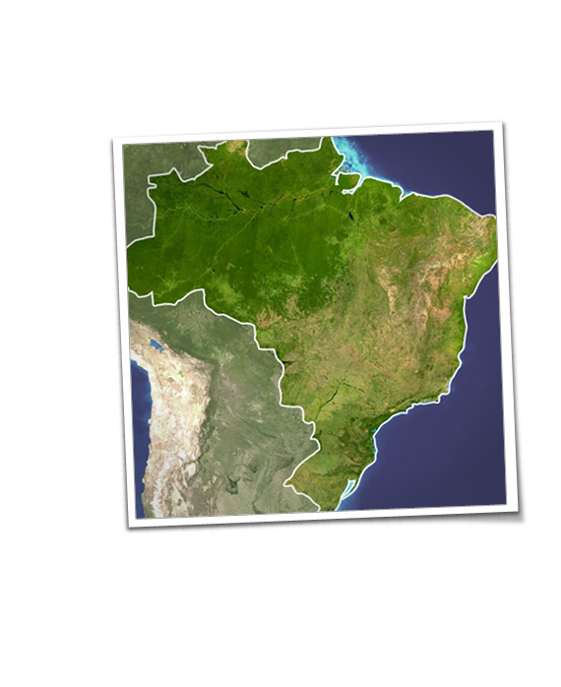



International Upstream Investments: Legal Framework
Warsaw 01/03/2013

Slide 2

1. Types of Investor
Oil and Gas Company
- IOC/NOC
- Major Company
- Independent Company
- Small Company
b) Others
Oil and gas Service Companies
Investment Fund

Slide 3
2. Strategy
  2.1 Location
Onshore
b) Offshore
b.1 shallow waters
b.2 deep waters

Slide 4
2. Strategy continuation
  2.2. Stage
Frontier
b) Traditional
c) Mature

Slide 5
2. Strategy continuation
  2.3. Type of play
Conventional
b) Unconventional
Shale gas
Tight Gas
Shale Oil
Etc

Slide 6
2. Strategy continuation
  2.4 Level of exposure
Political risk
b) Security Risk
c) Geological Risk
d) Technical Risk
e) Environmental Risk
f) Financial Risk (e.g. fiscal terms)
g) Bureaucracy Risks (e.g. delays)

Slide 7
3. Acquisition/Negotiation
Bid round/Direct Negotiation
- Concession Agreement/Licence
- PSC
- Service Contract
- Hybrid
*JSA/JBA
b) Farm-in
FOA
JOA

Slide 8
5. Investment Protections
BIT
b) DTT
c) Stabilisation Provision

Slide 9
6. Structure of the Investment
a) Is it required a local company by the local law?
b) If so should it be a subsidiary or a branch? What is the most efficient legal structure?
c) Should you have one block per contract ?
d) Should you have one contract per company?

Slide 10
7. Operations
Required Staff (local content issue)
b) Who are the companies available to operate in this environment?
Prepare and approve a WPB
d) How will you fund the operations?
d) Comply with local laws & Implement best practices

Slide 11

7. Conclusion
Clear goals
b) Efficient Structure
b) Flexibility
d) Agility

Slide 12

Takk !!
egp@strholding.com

